Slide 1
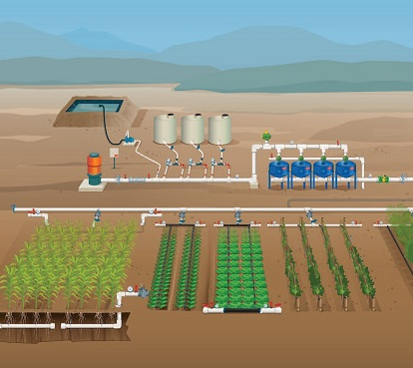
Futuristic Farming with AgroMation

Slide 2
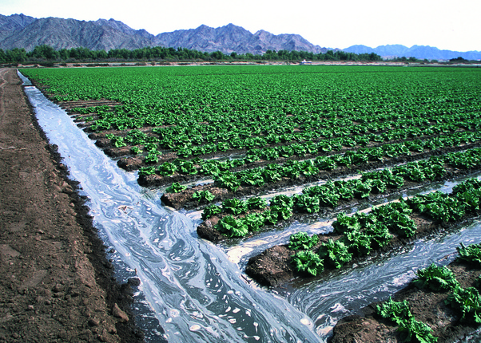
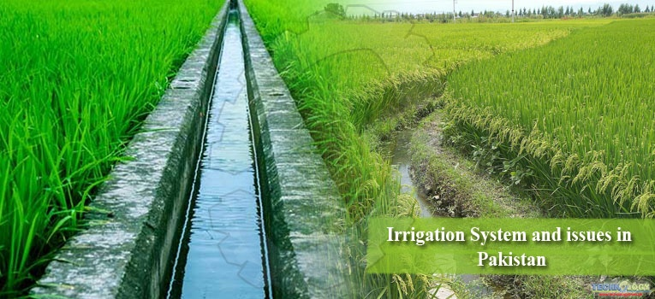
Pakistan wastes 10 Trillion gallons
of water annually.

